Slide 1

Engineering
Economics
Lecture-1

Slide 2
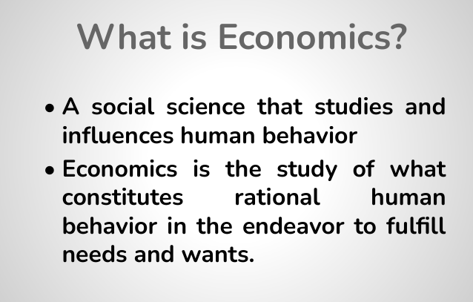
Need- Basic issues for survival.
Want
Demand=Willingness to purchase+ Purchasing power
Unlimited Needs
Scarcity

Slide 3
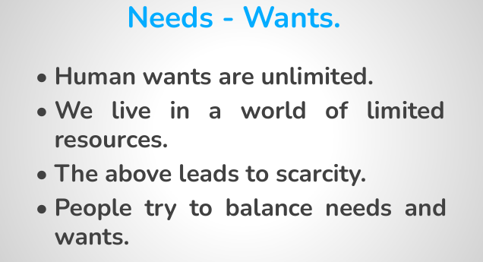

Slide 4
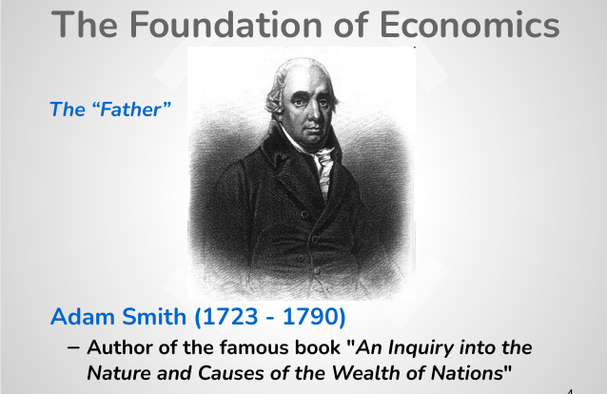

Slide 5
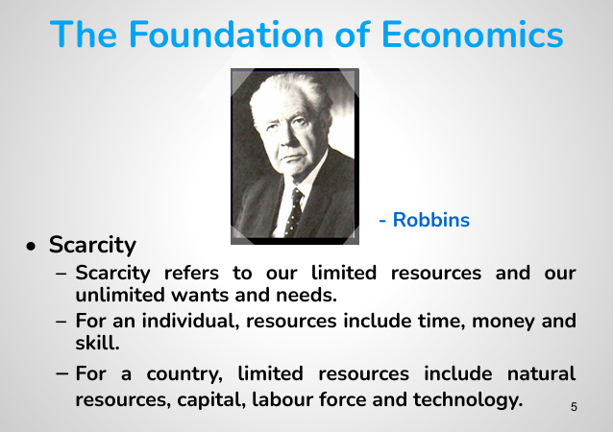

Slide 6
Definition of Economics
Economics is the science which studies human behavior as a relationship between given ends and scarce means which have alternative uses.
Economics is a social science concerned with the production, distribution, and consumption of goods and services.
It studies how individuals, businesses, governments, and nations make choices about how to allocate resources.

Slide 7
Two branches of Economics
Two major types of economics are Microeconomics and Macroeconomics.
Microeconomics focuses on individual consumers and businesses. And Macroeconomics deals with the behavior of the aggregate economy- overall economies on a regional, national, or international scale.
Macroeconomics is the branch of economics that looks at economy in a broad sense and deals with factors affecting the national, regional, or global economy as a whole. Microeconomics looks at the economy on a smaller scale and deals with specific entities like businesses, households and individuals.

Slide 8
Micro-economics
Micro, as its name implies, focuses on smaller (albeit just as important) concerns that involve individual people, families, or entities.
Microeconomics focuses on how individual consumers and firm make decisions; these individuals can be a single person, a household, a business/organization or a government agency.
The key role of microeconomics is to examine how a company could maximize its production and capacity, so that it could lower the prices and compete in its industry. A lot of microeconomics information can be obtained from the financial statements.
The key factors of microeconomics are as follows: Demand, supply and equilibrium, Production theory, Costs of production.

Slide 9
Macroeconomics
'Macro' refers to the big picture.
Macroeconomics studies an overall economy on both a national and international level.
Its focus can include a distinct geographical region, a country, a continent, or even the whole world.
Topics studied include foreign trade, government fiscal and monetary policy, unemployment rates, the level of inflation and interest rates, the growth of total production output as reflected by changes in the Gross Domestic Product (GDP), and business cycles (Business cycles are comprised of concerted cyclical upswings and downswings in the broad measures of economic activity—output, employment, income, and sales).

Slide 10
Why is Economics Important?
Economists provide information and forecasting to inform decisions within companies and governments.
Economic issues influence our daily lives. This includes issues such as tax and inflation, interest rates and wealth, inequality and emerging markets, and energy and the environment.
Firms of all sizes and industries have to rely on economics, whether that’s for product research and development, pricing strategies or how to advertise.

Slide 11
Why studying Economics is Important?
Economics helps to bring about development and minimize poverty in a country. The reason many African and Asian countries are finding it difficult to develop like Europe and America is mainly due to the fact many of these nations aren’t fully using Economics to solve certain problems such as high unemployment rate, low production etc.
Economics is very vital for the businessman or businesswoman in the sense that a thorough understanding in Economics can help him or her to minimize the cost of production and make more profit at the end of the day.

Slide 12
Engineering economics as a distinct branch
1. Bridges Technical and Financial Thinking
Engineers often make decisions that involve significant capital investment. A separate course in Engineering Economics trains them to evaluate the economic feasibility of projects (e.g., cost-benefit analysis, break-even points, return on investment).
2. Specialized Decision-Making Tools
Unlike general economics, Engineering Economics focuses on practical tools like:
  Time value of money
  Net present value (NPV)
  Internal rate of return (IRR)
  Depreciation methods
These tools are tailored for engineers managing projects, systems, and technologies.
3. Optimizes Resource Allocation
Engineers frequently allocate scarce resources under constraints. Engineering Economics helps identify cost-effective solutions and optimize designs based on both performance and cost.

Slide 13
Engineering economics as a distinct branch
4. Different from Traditional Economics
General economics focuses on markets, consumers, and macro/micro theories. Engineering Economics focuses on project-level decisions, often in a deterministic and quantitative framework.
5. Critical for Sustainable and Ethical Decision-Making
Engineers today must consider sustainability, social impact, and long-term costs. A distinct course equips them to weigh economic and ethical trade-offs.

Slide 14
Questions we can answer from this lecture
1.Define Economics / Microeconomics/ Macroeconomics/ Engineering Economics.
2.Write down the differences between Microeconomics and Macroeconomics.
3.Why studying economics is important?
4.Why engineering economics should be taught as a distinctive branch?

Slide 15
Engineering
Economics
Lecture-2

Slide 16
The economic problem
All societies face the economic problem, which is the problem of how to make the best use of limited, or scarce, resources.
The economic problem exists because, although the needs and wants of people are endless, the resources available to satisfy needs and wants are limited.
Resources are limited in two essential ways:
Limited in physical quantity, as in the case of land, which has a finite quantity.
Limited in use, as in the case of labour and machinery, which can only be used for one purpose at any one time.

Slide 17
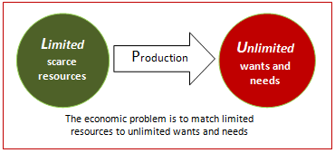
The economic problem

Slide 18
Choice and Opportunity cost
Choice and opportunity cost are two fundamental concepts in economics.
Given that resources are limited, producers and consumers have to make choices between competing alternatives. Individuals must choose how best to use their skill and effort, firms must choose how best to use their workers and machinery, and governments must choose how best to use taxpayer’s money.

Slide 19
Choice and Opportunity cost
Making an economic choice creates a sacrifice because alternatives must be given up.
Making a choice results in the loss of benefit that an alternative would have provided. For example, land and other resources, which have been used to build a school could have been used to build a factory. The loss of the next best option represents the real sacrifice and is referred to as opportunity cost.
The opportunity cost of choosing the school is the loss of the factory, and what could have been produced.

Slide 20
The economic problem
America’s first Nobel Prize winner for economics, the late Paul Samuelson, is often credited with providing the first clear and simple explanation of the economic problem – namely, that in order to solve the economic problem societies must endeavor to answer three basic questions –
What to produce?
How to produce? And,
For whom to produce?

Slide 21
Factors of Production
Land;
Labor;
Capital; and
Entrepreneurship;
Knowledge

Slide 22
The economic problem
What to produce?
Societies have to decide the best combination of goods and services to meet their varied wants and needs. Societies must decide what quantities of different resources should be allocated to these goods and services.
How to produce?
Societies also have to decide the best combination of factors to create the desired output of goods and services. For example, precisely how much land, labor, and capital should be used to produce consumer goods such as computers and motor cars?
For whom to produce?
Finally, all societies need to decide who will benefit from the output from its economic activity, and how much they will get. This is often called the problem of distribution.

Slide 23
Production Possibility Frontier (PPF)
Every economy performs with a limited amount of resources, but expects to produce goods and services to satisfy unlimited needs and wants of the individuals.
Hence, it is a great importance to allocate these limited resources across an unlimited amount of needs and wants, which is identified as a primary concern of any economy.
Production Possibility Frontier (PPF), also known as Production Possibility Curve (PPC) is a concept that discusses this economic problem and illustrates how to make choices in a scarcity situation.
This model graphically represents a hypothetical situation of how to make a choice between two goods.

Slide 24
Production Possibility Frontier (PPF)
A PPF shows all the possible combinations of two goods, or two options available at one point in time.
PPF primarily represents a hypothetical boundary between the maximum combination of goods and services that an economy can produce with the available resources and technology. This model is based on three main assumptions.
Assumptions:
The economy has fixed amount of resources and technology.
All the resources in the economy are fully employed.
An economy produces only two types of goods at a time, and the choice is made between those two goods

Slide 25
Production Possibility Frontier (PPF)
Example: Assume that a particular economy produces two types of goods: machines and food. Accordingly, the following graph represents the maximum combination of these two goods that can be produced using the scarce resources.

Slide 26
Production Possibility Frontier (PPF)
Machines (Units) | Food (Units)
5 | 0
4 | 100
3 | 200
2 | 300
1 | 400
0 | 500

Slide 27
Production Possibility Frontier (PPF)
In the Production Possibility Curve, the graph represents the maximum combination of two goods that an economy can produce utilizing resources and technology optimally.
Therefore, the society has to make the choice somewhere within or under the curve. Let’s discuss different areas that are important under PPF concepts.

Slide 28
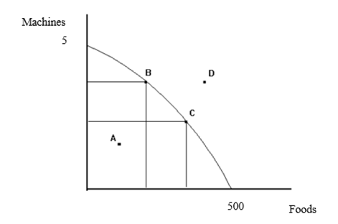
Production Possibility Frontier (PPF)

Slide 29
Production Possibility Frontier (PPF)
Point A: This is an achievable product combination for an economy with the existing amount of resources and technology. However, this is not an efficient product combination as the society can obtain more goods from both products without sacrificing another good.
Point D: This is an unachievable product combination; an economy cannot produce this with the existing amount of resources and technology. This also indicates the limited amount of resources that an economy has to utilize for its production.

Slide 30
Production Possibility Frontier (PPF)
Point B and C: These two points are achievable product combinations that can be produced by the existing resources and technology of the economy. These two points are efficient points on the PPF.
Point B indicates a choice of more machines and less food whilst point C indicates the reverse. Moreover, if the society needs to move from point B to point C, a certain amount of a product has to be sacrificed.
This is identified as the trade-off between machines and food items. On the other hand, since the society has to give up one choice for another, PPF represents the scarcity of resources as well.

Slide 31
Economic systems
Free market economies
A free market economy is a type of economy that promotes the production and sale of goods and services, with little to no control or involvement from any central government agency. This economic system is primarily based on supply and demand.
In a free-market economy, firms and households act in their own self-interest to determine how resources get allocated, what goods get produced, and who buys the goods.
laissez-faire economics (a term often used synonymously with the idea of the free market).
A purely capitalist economy is a free market economy; the profit motive drives all commerce and forces businesses to operate as efficiently as possible to avoid losing market share to competitors.

Slide 32
Economic systems
A free market economy is one that is governed strictly by the forces of supply and demand with no governmental influence. In practice, however, nearly all legal market economies must contend with some form of regulation. A pure market economy has no barriers to economic exchange: you can sell anything to anyone else for any price.
In reality, this form of economics is rare. Sales taxes, tariffs on imports and exports, and legal prohibitions—such as the age restriction on liquor consumption—are all impediments to a truly free market exchange.
Hong Kong's economy is considered the most free, followed by New Zealand while Algeria and was the least free in 2019, according to the 2019 Index of Economic Freedom.

Slide 33
Efficiency-Avoiding Wastages

Slide 34
Economic systems
Free market economies
In a free market economy, resources are allocated through the interaction of free and self-directed market forces.
This means that what to produce is determined consumers, how to produce is determined by producers, and who gets the products depends upon the purchasing power of consumers.

Slide 35
Economic systems
Command economies
A command economy is a system where the government, rather than the free market, determines what goods should be produced, how much should be produced, and the price at which the goods are offered for sale. It also determines investments and incomes.
The command economy is a key feature of any communist society. Cuba, North Korea, and the former Soviet Union are examples of countries that have command economies, while China maintained a command economy for decades before transitioning to a mixed economy that features both communistic and capitalistic elements.

Slide 36
Economic systems
Also known as a planned economy, command economies have as their central tenet that government central planners own or control the means of production within a society. Private ownership or land, labor, and capital is either nonexistent or sharply limited to use in support of the central economic plan.
In contrast with free market economies, in which the prices of goods and services are set by supply and demand, central plans in a command economy set prices, control production, and limit or entirely prohibit competition within the private sector. In a pure command economy, there is no competition, as the central government owns or controls all business.

Slide 37
Economic systems
Mixed economies
There is a third type of economy involving a combination of market forces and central planning, called mixed economies.
Mixed economies may have a distinct private sector, where resources are allocated primarily by market forces. Mixed economies may also have a distinct public sector, where resources are allocated mainly by government, such as defence, police, and fire services.
A mixed economic system protects private property and allows a level of economic freedom in the use of capital, but also allows for governments to interfere in economic activities in order to achieve social aims.

Slide 38
Economic systems
Free market economies and command economies exist more as concepts than as tangible realities; almost all of the world's economies feature elements of both systems and are classified as mixed economies.
For example, although the United States allows companies to set prices and workers to negotiate wages, the government establishes parameters such as minimum wages that must be followed. Additionally, most countries have some type of taxation and impose import and export tariffs.

Slide 39
Consumer Demand
Consumer demand is defined as the ‘..willingness and ability of consumers to purchase a quantity of goods and services in a given period of time, or at a given point in time..’.
Merely being willing to make a purchase does not constitute effective demand – willingness must be supported by an ability to pay.
In short, desire needs purchasing power to turn it into effective demand. Purchasing power is determined by current consumer income in relation to the current price level.

Slide 40
law of Demand
The law of demand states that quantity purchased varies inversely with price.
In other words, the higher the price, the lower the quantity demanded.

Slide 41
Demand curve formula
Qd = a – b(P)
Q = quantity demanded
a = all factors affecting QD other than price (e.g. income, fashion)
b = slope of the demand curve
P = Price of the good.

Slide 42
Demand Schedule
Quantity | Price
40 | 0
38 | 1
36 | 2
34 | 3
32 | 4
30 | 5
28 | 6
26 | 7
0 | 20

Slide 43
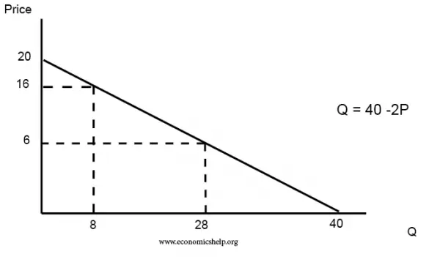
Demand Curve

Slide 44
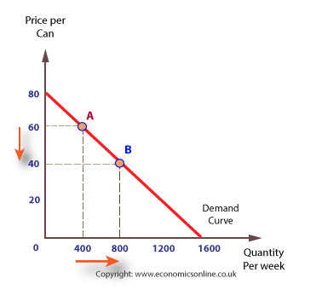
law of demand

Slide 45
Non-price Determinants
The needs of the consumer
If a good or service is a necessity then, assuming the consumer has sufficient income, it is likely to be demanded irrespective of its price. The greater the need for a product, the greater the demand.
Consumer income (Y)
Generally, for normal goods, the higher the income of a consumer the greater the quantity demanded. However, with inferior goods, an increase in income will lead to a reduction in demand.
For example, individuals on very low incomes are less likely to demand new motor cars, and more likely to take the bus. However, if they obtain higher income, demand for public transport may fall, while the demand for private transport is likely to rise. In this case, private transport is a normal good and public transport an inferior one.

Slide 46
Non-price determinants
Consumer tastes, preferences and fashions
Tastes can change over time, as can preferences and fashions, and demand can increase or decrease to reflect these changes.
Habit
Some products, like alcohol, gambling, and cigarettes, are addictive. The stronger the addiction, the greater the demand. Addiction to a product may interfere with rational decision making as individuals forgo their own self-interest.

Slide 47
Non-price determinants
Brand loyalty
Consumers may become loyal to particular brands, and this can have a significant influence on how consumers allocate their income. Brands give consumers confidence and take some of the risk out of purchasing.
The price of substitute products
Changes in the price of substitutes can greatly affect demand. An increase in the price of a close substitute will result in an increase in the demand for a product, as consumers switch from the substitute. For example, an increase in the price of one brand of petrol is likely to result in an increase in demand for a substitute brand.

Slide 48
Substitute products vs. Complementary products

Slide 49
Non-price determinants
The price of complementary products
Many products have complements, which are either bought at the same time as the product, or are needed to make the product work. For example, batteries are a complement to many portable electronic products. As the price of complements rise, the demand for a product is likely to fall. A situation where complementary products are bought at the same time it is referred to as joint demand.
The impact of advertising
Successful advertising can have a considerable influence on consumer demand. Advertising can increase consumer awareness of a product and encourage consumption.

Slide 50
Non-price determinants
Knowledge
Knowledge, or ignorance, can affect the pattern of consumer demand. If a rational consumer knows that a product is harmful or beneficial to them they may reduce or increase their demand accordingly. Knowing that information and ignorance affect consumer demand, producers may attempt to encourage consumption through positive and persuasive advertising.
Natural factors
The impact of good or bad weather and other natural factors can have a considerable impact on demand. Certain products are highly dependent on weather or natural conditions, such as the demand for ice cream, raincoats, and holidays.

Slide 51
Exceptions to the Law of Demand
Giffen Goods is a concept that was introduced by Sir Robert Giffen. These goods are goods that are inferior in comparison to luxury goods. However, the unique characteristic of Giffen goods is that as its price increases, the demand also increases.
A Giffen good, a concept commonly used in economics, refers to a good that people consume more as the price rises. Therefore, a Giffen good shows an upward-sloping demand curve and violates the fundamental law of demand.
Giffen goods are basic, low-cost, and often essential goods, whereas Veblen goods are mostly luxury, status-symbol items—like perfumes and certain cars—that see their demand climb as their prices rise.

Slide 52
Exceptions to the Law of Demand
Potatoes: As one example of a Giffen good, think of the surging price and demand for this root vegetable during the Irish potato famine in the mid-1800s. Given the fact there were few substitutes available at the time, the inflated price of potatoes didn’t prevent Irish citizens from demanding more of the food to feed themselves and their families.
People would buy up as much as possible because they were unsure if greater shortages were on the horizon.

Slide 53
Exceptions to the Law of Demand
The second exception to the law of demand is the concept of Veblen goods. Veblen Goods is a concept that is named after the economist Thorstein Veblen, who introduced the theory of “conspicuous consumption“.
According to Veblen, there are certain goods that become more valuable as their price increases. If a product is expensive, then its value and utility are perceived to be more, and hence the demand for that product increases.
And this happens mostly with precious metals and stones such as gold and diamonds and luxury cars such as Rolls-Royce. As the price of these goods increases, their demand also increases because these products then become a status symbol.

Slide 54
Exceptions to the Law of Demand
Another exception to the law of demand is necessary or basic goods. People will continue to buy necessities such as medicines or basic staples such as sugar or salt even if the price increases.
Sometimes the demand for a product may change according to the change in income. If a household’s income increases, they may purchase more products irrespective of the increase in their price, thereby increasing the demand for the product. Similarly, they might postpone buying a product even if its price reduces if their income has reduced.

Slide 55
Exceptions to the Law of Demand
Bandwagon Effect: This is the most common type of exception to the law of demand wherein the consumer tries to purchase those commodities which are bought by his friends, relatives or neighbors. Here, the person tries to emulate the buying behavior and patterns of the group to which he belongs irrespective of the price of the commodity.
For example, if the majority of group members have smart phones then the consumer will also demand for the smartphone even if the prices are high.

Slide 56


Slide 57
Price Elasticity of Demand
Price Elasticity of Demand (PED) is defined as the responsiveness of quantity demanded to a change in price.
Demand is said to be elastic when the change in demand is proportionally larger than the change in price. In other words, demand is elastic when the demand changes significantly with smaller price changes.
Conversely, demand is inelastic when the change in demand is proportionally smaller than the difference in price.

Slide 58
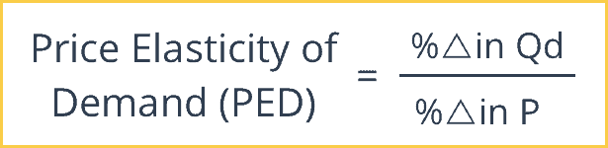
Price Elasticity of Demand

Slide 59
Change in QD=(200-186)units=14 units
Change in P=(115-100)units=15 TAKA

Slide 60
Price Elasticity of Demand
%∆ in Q_{d} = Percentage Change in Quantity Demanded. The Percentage Change in Quantity Demanded is the New Quantity Demanded minus the Old Quantity Demanded divided by the Old Quantity Demanded.
%∆ in P = Percentage Change in Price. This is the New Price minus the Old Price divided by the Old Price.

Slide 61
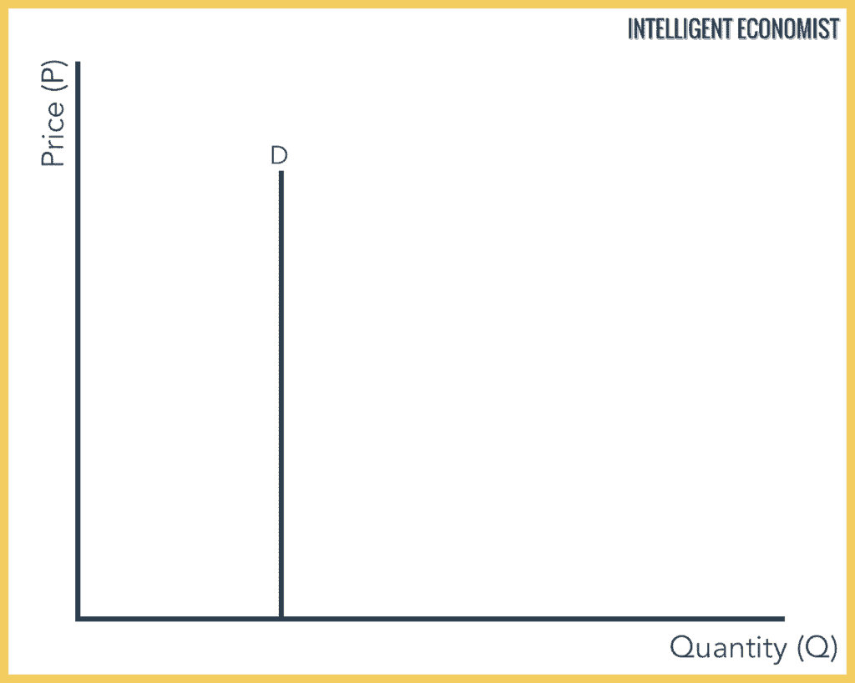
Perfectly Inelastic Demand, (PED = 0)

Slide 62
Perfectly Inelastic Demand, (PED = 0)
With a perfectly inelastic demand, there is no change in the demand for a product with a change in its price. This means that the demand remains constant for any value of price. The demand curve is represented as a straight vertical line.
It is practically impossible to find a product that has a perfectly inelastic demand. The closest thing could be essentials like water or certain food products.

Slide 63
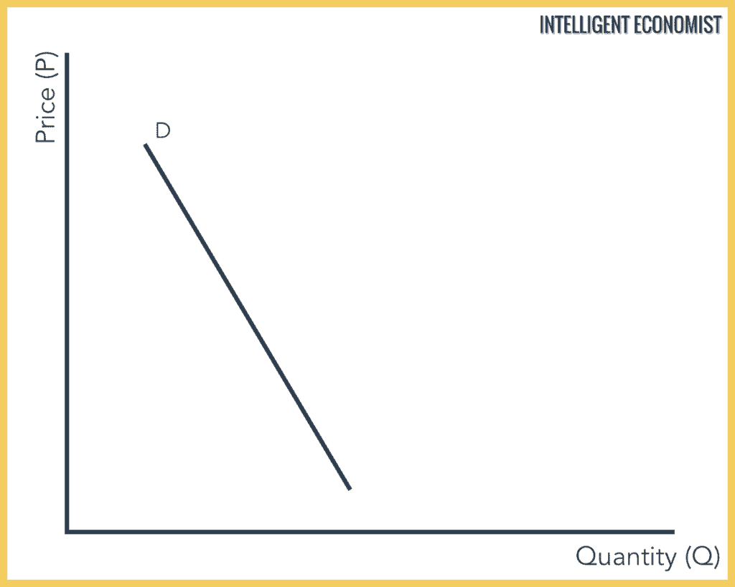
Relatively Inelastic Demand, (PED = 0 < x < 1)

Slide 64
Relatively Inelastic Demand, (PED = 0 < x < 1)
Relatively inelastic demand occurs when the percentage change in demand is less than the percentage change in the price of a product.
For example, if the price of a product increases by 15% and the demand for the product decreases only by 7%, then the demand would be called relatively inelastic.

Slide 65
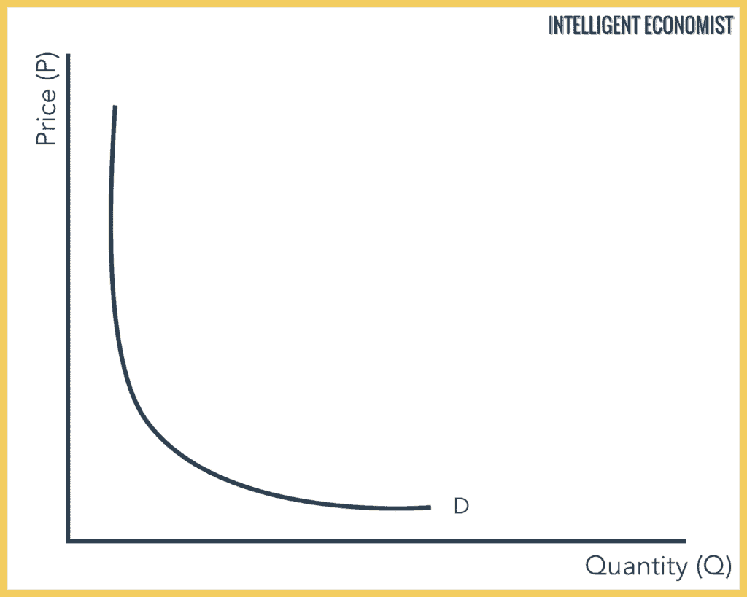
Unit Elastic Demand, (PED = 1)

Slide 66
Unit Elastic Demand, (PED = 1)
Demand is said to be unit elastic when the proportionate change in demand produces the same change in the price. The quantity demanded changes by the same percentage as the change in price.

Slide 67
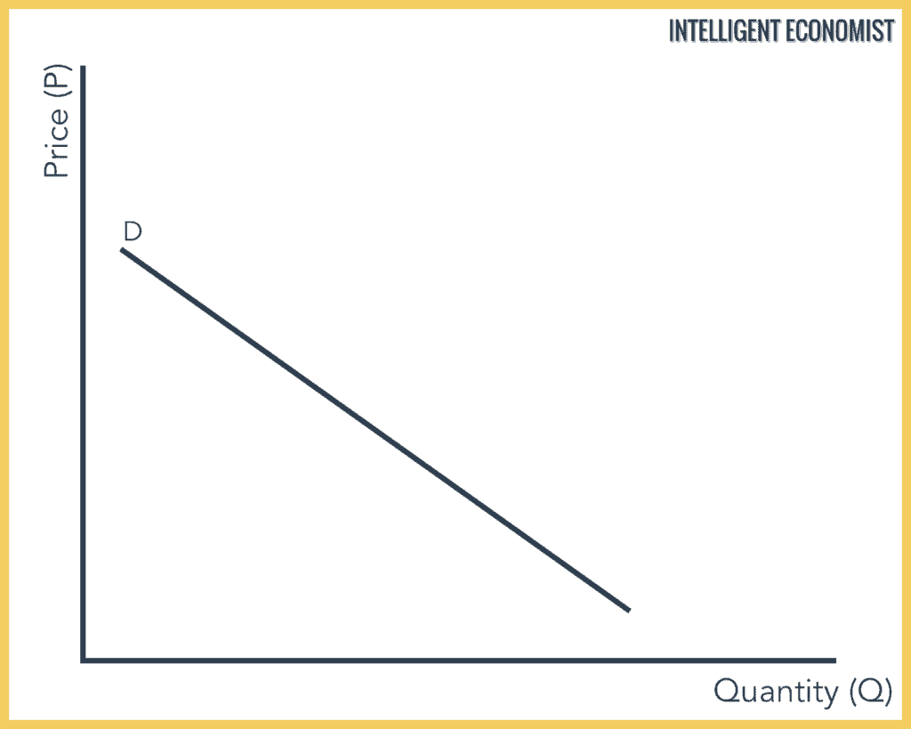
Relatively Elastic Demand, (PED = 1 < x < ∞)

Slide 68
Relatively Elastic Demand, (PED = 1 < x < ∞)
Relatively elastic demand is defined as the proportionate change produced in demand is greater than the proportionate change in the price of a product. The quantity demanded changes by a larger percentage than the change in price.
For example, if the price of a product increases by 10% and then the demand for the product decreases by 15%, then the demand would be relatively elastic.

Slide 69
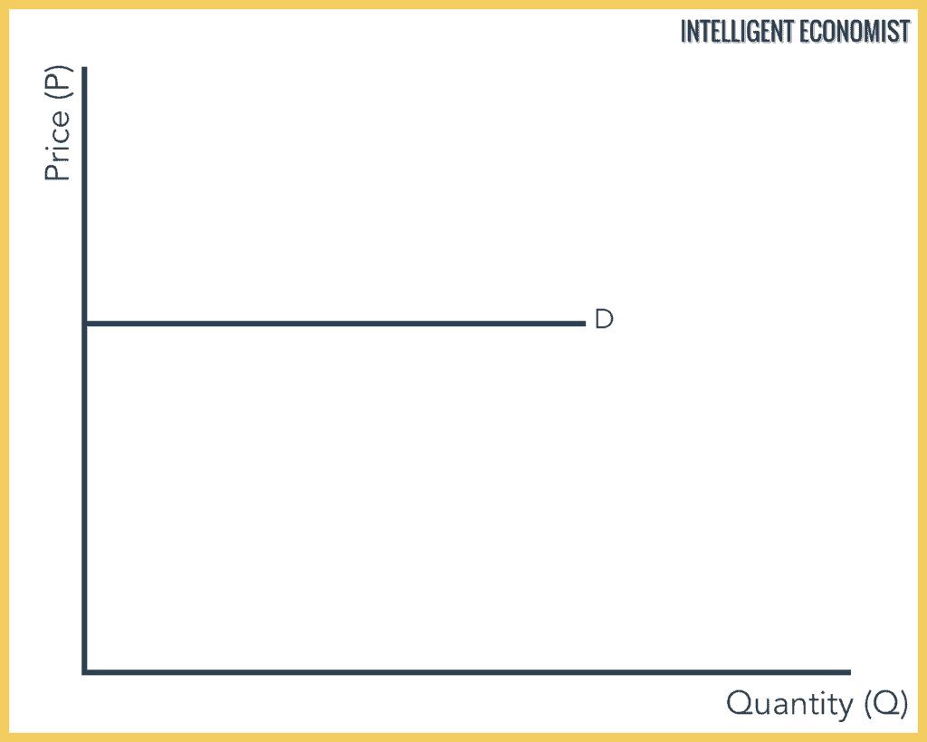
Perfectly Elastic Demand, (PED = ∞)

Slide 70
Perfectly Elastic Demand, (PED = ∞)
In Perfectly Elastic Demand, a small rise in price will result in a fall in demand to zero, while a small fall in price will result in the demand to become infinite. Consumers will buy all available at some price, but none at any other price.
This is a theoretical concept because it requires perfect competition where the slightest price increase results in zero demand.
In a perfectly elastic demand, the demand curve is represented as a horizontal straight line.

Slide 71
What Is Utility?
Utility is a term in economics that refers to the total satisfaction received from consuming a good or service.
Economic theories based on rational choice usually assume that consumers will strive to maximize their utility.
The economic utility of a good or service is important to understand, because it directly influences the demand, and therefore price, of that good or service.

Slide 72
Customers vs consumers-final users

Slide 73
Diminishing Marginal Utility
One of the earliest explanations of the inverse relationship between price and quantity demanded is the law of diminishing marginal utility. This law suggests that as more of a product is consumed the marginal (additional) benefit to the consumer falls, hence consumers are prepared to pay less. This can be explained as follows:
Most benefit is generated by the first unit of a good consumed because it satisfies most of the immediate need or desire.
A second unit consumed would generate less utility – perhaps even zero, given that the consumer has less need or less desire.
With less benefit derived, the rational consumer is prepared to pay rather less for the second, and subsequent, units, given that the marginal utility falls.

Slide 74
Diminishing marginal utility
Consider the following figures for utility derived by an individual when consuming bars of chocolate.
BARS | TOTAL UTILITY | MARGINAL UTILITY
1 | 100
2 | 190 | 90
3 | 270 | 80
4 | 340 | 70
5 | 400 | 60
6 | 450 | 50
7 | 490 | 40
8 | 520 | 30
9 | 540 | 20

Slide 75
Diminishing marginal utility
While total utility continues to rise from extra consumption, the additional (marginal) utility from each bar falls. If marginal utility is expressed in a monetary form, the greater the quantity consumed the lower the marginal utility and the less the rational consumer would be prepared to pay.

Slide 76
Supply
Production is the process of turning inputs of scarce resources into an output of goods or services. The role of a firm is to organize scarce resources to satisfy consumer demand in a profitable way.
Supply is defined as the willingness and ability of firms to produce a given quantity of output in a given period of time, or at a given point in time, and take it to market.
Not all output is taken to market, and some output may be stored and released onto the market in the future.
Supply can be measured for a single factor of production, for a single firm, for an industry and for the whole economy.

Slide 77
Determinants of supply
Price
The price of the product is the starting point in building a model of supply. The supply model assumes that price and quantity supplied are directly related.
The availability of factors of production
The availability of factors of production, such as labour or raw materials, can affect the amount that can be produced and supplied. For example, if a firm producing motor vehicles experiences a shortage of steel for its body panels, then its ability to produce vehicles will be reduced.

Slide 78
Determinants of supply
Cost of factors
Changes in costs will alter a firm’s calculation of how much to supply at a given price. For example, if the same motor manufacturer experiences an increase in labour costs due to an increase in the wage rate, the cost of producing each vehicle will rise.
This means that the price the manufacturer expects to receive will increase. If the price does not increase, less will be produced.

Slide 79
Determinants of supply
New firms entering the market
In terms of total supply to a market, the number of firms in the market will affect the total supply. New firms in a market will increase market supply and firms leaving will reduce supply.
New firms may be attracted into a market because of the expectation of profits and existing firms may leave because they cannot cover their costs, and make losses.

Slide 80
Determinants of supply
Weather and other natural factors
Changes in the weather can have a considerable impact on the ability to produce certain products, like farm produce and commodities.
Subsidies
Subsidies are funds given to firms to enable them to increase their supply or to reduce the price of their product to the consumer.
Subsidies can alter the firm’s willingness and ability to produce and supply.

Slide 81
What is the Law of Supply?
The law of supply is the microeconomic law that states that, all other factors being equal, as the price of a good or service increases, the quantity of goods or services that suppliers offer will increase, and vice versa.
The law of supply says that as the price of an item goes up, suppliers will attempt to maximize their profits by increasing the quantity offered for sale.

Slide 82
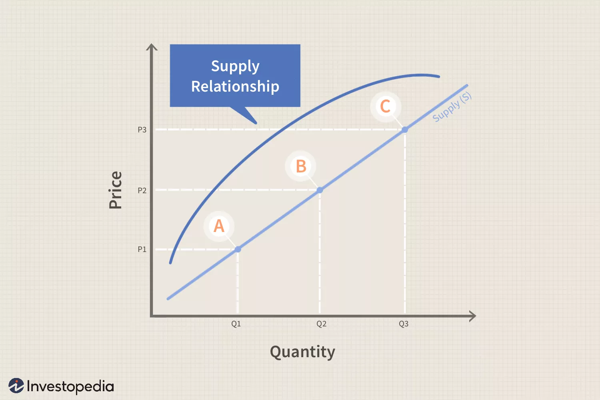
Law of Supply

Slide 83
Law of Supply
The chart depicts the law of supply using a supply curve, which is upward sloping. A, B and C are points on the supply curve. Each point on the curve reflects a direct correlation between quantity supplied (Q) and price (P). So, at point A, the quantity supplied will be Q1 and the price will be P1, and so on.
Consumer demand sets the price and sellers can only charge what the market will bear. If consumer demand rises over time, the price will rise, and suppliers can choose devoted new resources to production (or new suppliers can enter the market) which increases the quantity supplied. Demand ultimately sets the price in a competitive market, supplier response to the price they can expect to receive sets the quantity supplied.

Slide 84
EQUILIBRIUM
The equilibrium price and equilibrium quantity occur where the supply and demand Intersect. The equilibrium occurs where the quantity demanded is equal to the quantity supplied.
If the price is below the equilibrium level, then the quantity demanded will exceed the quantity supplied. Excess demand or a shortage will exist.
If the price is above the equilibrium level, then the quantity supplied will exceed the quantity demanded. Excess supply or a surplus will exist.
In either case, economic pressures will push the price toward the equilibrium level.

Slide 85
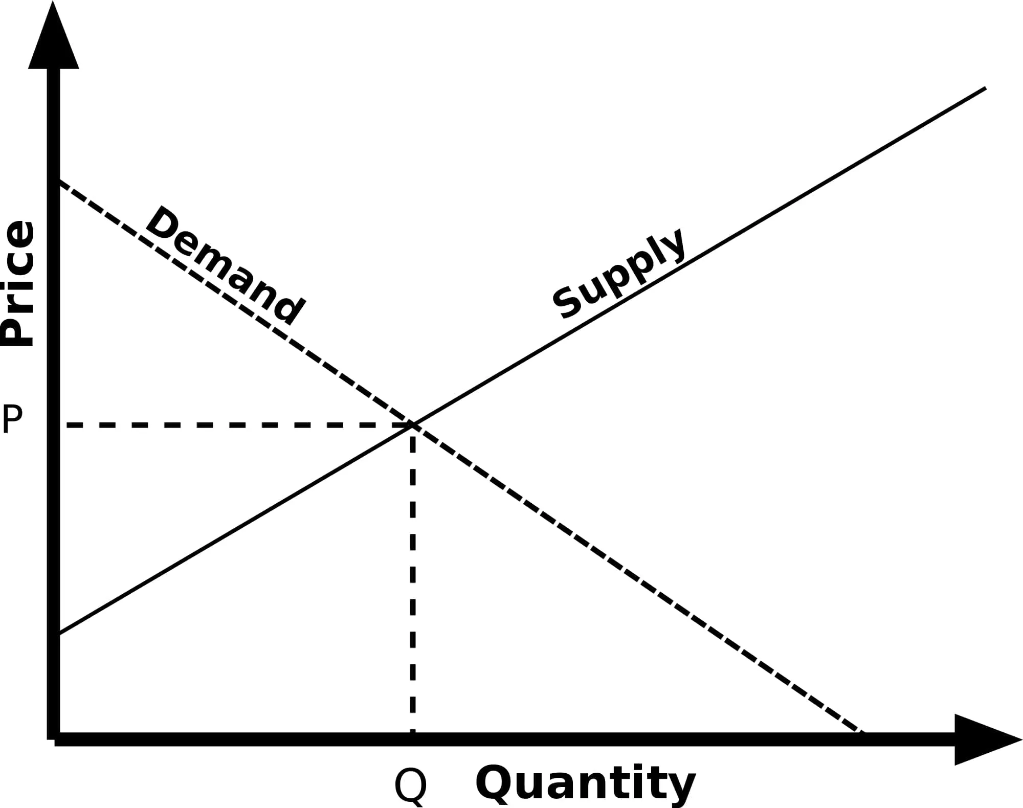
EQUILIBRIUM

Slide 86
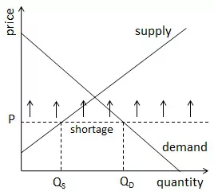
EQUILIBRIUM: Example of Low Prices

Slide 87
EQUILIBRIUM: Example of Low Prices
If the price in a market is lower than P*, the quantity demanded by consumers will be larger than the quantity supplied by producers. A shortage will therefore result.
Producers will notice this shortage, and the next time they have the opportunity to make production decisions they will increase their output quantity and set a higher price for their products.
As long as a shortage remains, producers will continue to adjust in this way, bringing the market to the equilibrium price and quantity at the intersection of supply and demand.

Slide 88
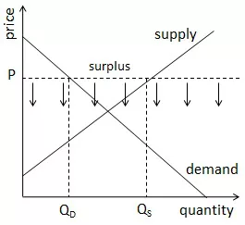
EQUILIBRIUM: Example of high Prices

Slide 89
EQUILIBRIUM: Example of high Prices
If the price is higher than P*, the quantity supplied in that market will be higher than the quantity demanded at the prevailing price, and a surplus will result.
When a surplus occurs, firms either accumulate inventory (which costs money to store and hold) or they have to discard their extra output. This is clearly not optimal from a profit perspective, so firms will respond by cutting prices and production quantities when they have the opportunity to do so.
This behavior will continue as long as a surplus remains, again bringing the market back to the intersection of supply and demand.

Slide 90
What is an Indifference Curve?
This is based on consumer preference and belief that we cannot quantitatively measure human satisfaction in monetary terms. This approach assigns an order to consumer preferences rather than measure them in terms of money.
An indifference curve is a curve that represents all the combinations of goods that give the same satisfaction to the consumer. Since all the combinations give the same amount of satisfaction, the consumer prefers them equally. Hence the name indifference curve.

Slide 91
What is an Indifference Curve?
Peter has 1 unit of food and 12 units of clothing. Now, we ask Peter how many units of clothing is he willing to give up in exchange for an additional unit of food so that his level of satisfaction remains unchanged.
Peter agrees to give up 6 units of clothing for an additional unit of food. Hence, we have two combinations of food and clothing giving equal satisfaction to Peter as follows:
1 unit of food and 12 units of clothing
2 units of food and 6 units of clothing

Slide 92
What is an Indifference Curve?
Combination | Food | Clothing
A | 1 | 12
B | 2 | 6
C | 3 | 4
D | 4 | 3

Slide 93
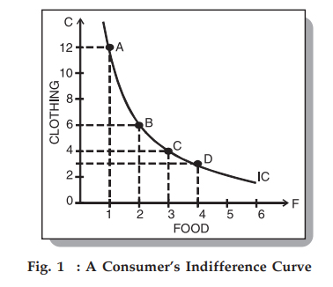
What is an Indifference Curve?

Slide 94
Marginal Rate of Substitution
This is the rate at which a consumer is prepared to exchange a good X for Y. If we go back to Peter’s example above, we have the following table:
Interestingly, as Peter accumulates more units of food, the MRS starts falling – meaning he is prepared to give up fewer units of clothing for food. There are two reasons for this:
As Peter gets more units of food, his intensity of desire for additional units of food decreases.
Most of the goods are imperfect substitutes for one another. If they could substitute one another perfectly, then MRS would remain constant.

Slide 95
Marginal Rate of Substitution
Combination | Food | Clothing | MRS
A | 1 | 12 | –
B | 2 | 6 | 6
C | 3 | 4 | 2
D | 4 | 3 | 1

Slide 96
Properties of an Indifference Curve or IC
An IC slopes downwards to the right
This slope signifies that when the quantity of one commodity in combination is increased, the amount of the other commodity reduces. This is essential for the level of satisfaction to remain the same on an indifference curve.

Slide 97
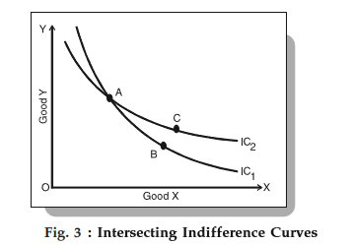
Properties of an Indifference Curve or IC
Indifference curves never intersect each other

Slide 98
Properties of an Indifference Curve or IC
Since points A and B lie on IC1, they give the same satisfaction level to an individual. Similarly, points A and C give the same satisfaction level, as they lie on IC2. Therefore, we can imply that B and C offer the same level of satisfaction, which is logically absurd. Hence, no two ICs can touch or intersect each other.
A higher IC indicates a higher level of satisfaction as compared to a lower IC
A higher IC means that a consumer prefers more goods than not.

Slide 99
Properties of an Indifference Curve or IC
An IC does not touch the axis
This is not possible because of our assumption that a consumer considers different combinations of two commodities and wants both of them.
If the curve touches either of the axes, then it means that he is satisfied with only one commodity and does not want the other, which is contrary to our assumption.

Slide 100
Diminishing Marginal Productivity
Diminishing marginal productivity in economics states that a small change in a variable input or a factor of production can initially create a small positive impact on the production output, and the positive impact starts reducing after a certain point.
This economic principle explains why production increases at a diminishing rate regardless of the increase in a specific input. It also explains the increase in the average cost of production along with the increase in productivity.
Therefore, a producer needs to identify the point after which the change will start bringing adverse effects on the process and become inefficient.

Slide 101
Productivity=output/Inputs

Slide 102
Diminishing Marginal Productivity
A restaurant facing a problem with customer waiting time hires additional two servers to increase productivity. Also, an adequate number of restaurant staff is essential to improve productivity and service. The restaurant also hired an experienced chef to prepare complex dishes.
Within months the result of hiring new staff was visible in the revenue figure. The restaurant is more organized now and running at optimal capacity. Motivated by the improvement in restaurant efficiency, the owner again hired two more servers and an experienced chef. However, the new addition didn’t cause a positive impact but increased the cost due to a salary increase. In essence, overstaffing caused a decline in productivity.

Slide 103
Diminishing Marginal Productivity
It causes if the production process involves fixed assets and becomes intense when inputs are limited in availability, and there is a low demand for the output, etc.
Diminishing marginal product is an important concept in economics. It helps to explain why firms may not always hire more workers even when there is an increase in demand. That is because the marginal product of labor decreases as more workers are hired. Thus, the cost of hiring additional workers may outweigh the benefit of increased output.

Slide 104
Market
In economics, market means a social system through which the sellers and purchasers of a commodity or a service (or a group of commodities and services) can interact with each other.
• They can participate in sale and purchase.
• Market does not refer to a particular place or location.
• It refers to an institutional relationship between purchasers and sellers.
• Market is an arrangement which links buyers and sellers.

Slide 105
Perfect Competition
Large number of buyers and sellers : Under perfect competition, there exists a large number of sellers and the share of an individual seller is too small in the total market output. As a result a single firm cannot influence the market price. Similarly, there are a large number of buyers and an individual buyer buys only a small portion of the total output available.
Homogenous goods : Under perfect competition all firms sell homogenous goods which are identical in quantity, shape, size, colour, packaging etc. So the products are perfect substitutes of each other

Slide 106
Perfect Competition
Free entry and free exit :
Any firm can enter or leave the industry whenever it wishes. The condition of free entry and free exit ensures that all the firms under perfect competition will earn normal profits in the long run.
If the existing firms are earning supernormal profits, new firms would be attracted to enter the industry and increases the total supply. This will reduce the market price and the supernormal profit will not sustain.

Slide 107
Perfect Competition
(iv) Profit maximization :- The goal of all firms is maximization of profit.
(v) No Government regulation :- There is no Government intervention in the market.
(vi) Perfect mobility of factors :- Resources can move freely from one firm to another without any restriction. The labours are not unionized and they can move between jobs and skills.
(vii) Perfect knowledge :- Individual buyer and seller have perfect knowledge about market and information is given free of cost. Each firm knows the price prevailing in the market and would not sell the commodity which is higher or lower than the market price. Similarly, each buyer knows the prevailing market price and he is not allowed to pay a higher price than that. The firm also has a perfect knowledge about the techniques of productions. Each firm is able to make use of the best techniques of production.

Slide 108
Monopoly
Monopoly refers to the market situation where there is one seller and there is no close substitute to the commodities sold by the seller. The seller has full control over the supply of that commodity. Features :
(i) Single seller and large number of buyers : Under monopoly there is one seller and therefore a firm faces no competition from other firms. Though there are large numbers of buyers, no single buyer can influence the monopoly price by his action.
(ii) No close substitute : Under monopoly there is no close substitute for the product sold by the monopolist. According to Prof. Boulding, a pure monopolist is therefore a firm producing a product which has no substitute among the products of any other firms.

Slide 109
(iii) Restriction on the entry of new firms : Under monopoly new firms cannot enter the industry.
(iv) Price maker :- A monopoly firm has full control over the supply of its products and hence it has full control over its price also. A monopoly firm can influence the market price by varying it supply, for eg., It can make the price of its product by supplying less of it.
(v) Possibility of Price Discrimination : Price discrimination is defined as that market situation where a single seller sell the same commodity at two different prices in two different markets at the same time, depending upon the elasticity of demand on the two goods in their respective market.

Slide 110
Cost Analysis
In economics, the Cost Analysis refers to the measure of the cost – output relationship, i.e. the economists are concerned with determining the cost incurred in hiring the inputs and how well these can be re-arranged to increase the productivity (output) of the firm.
In other words, the cost analysis is concerned with determining money value of inputs (labor, raw material), called as the overall cost of production.

Slide 111
Analysis of Costs
Short run is a period of time over which at least one factor must remain fixed. For most of the firms, the fixed resource or factors which cannot be increased to meet the rising demand of the good is capital i.e., plant and machinery.
Short run, then, is a period of time over which output can be changed by adjusting the quantities of resources such as labor, raw material, fuel but the size or scale of the firm remains fixed.
In the long run there is no fixed resource. All the factors of production are variable. The length of the long run differs from industry to industry depending upon the nature of production. For example, a balloon making firm can change the size of firm more quickly than a car manufacturing firm.

Slide 112
Types of Costs in the Short Run
(1) Total Fixed Cost (TFC):
Total fixed cost occur only in the short run. Total Fixed cost as the name implies is the cost of the firm's fixed resources, Fixed cost remains the same in the short run regardless of how many units of output are produced.
We can say that fixed cost of a firm is that part of total cost which does not vary with changes in output per period of time. Fixed cost is to be incurred even if the output of the firm is zero.
For example, the firm's resources which remain fixed in the short run are building, machinery and even staff employed on contract for work over a particular period.

Slide 113
Types of Costs in the Short Run
(2) Total Variable Cost (TVC):
Total variable cost as the name signifies is the cost of variable resources of a firm that are used along with the firm's existing fixed resources. Total variable cost is linked with the level of output. When output is zero, variable cost is zero. When output increases, variable cost also increases and it decreases with the decrease in output.
For example, wages paid to the labor engaged in production, prices of raw material which a firm. incurs on the production of output are variable costs.

Slide 114
Types of Costs in the Short Run
A firm can reduce its variable cost by lowering output but it cannot decrease its fixed cost. These expenses remain fixed in the short run.
In the long run there are no fixed resources. All resources are variable. Therefore, a firm has no fixed cost in the long run. All long run costs are variable costs.

Slide 115
Types of Costs in the Short Run
(3) Total Cost (TC):
Total cost is the sum of fixed cost and variable cost incurred at each level of output.
TC = TFC + TVC
Where:
TC = Total cost.
TFC = Total fixed cost.
TVC = Total variable cost.

Slide 116
Types of Costs in the Short Run
Units of Output (in Hundred) | Total Fixed Cost | Total Variable Cost | Total Cost
0 | 1000 | 0 | 1000
1 | 1000 | 60 | 1060
2 | 1000 | 100 | 1100
3 | 1000 | 150 | 1150
4 | 1000 | 200 | 1200
5 | 1000 | 400 | 1400
6 | 1000 | 700 | 1700
7 | 1000 | 1100 | 2100

Slide 117
Types of Costs in the Short Run
The short run cost data of the firm shows that total fixed cost TFC (column 2) remains constant at $1000/- regardless of the level of output.
The column 3 indicates variable cost which is associated with the level of output. Total variable cost is zero when production is zero. Total variable cost increases with the increase in output. The variable does not increase by the same amount for each increase in output. Initially the variable cost increases by a smaller amount up to 3rd unit of output and after which it increases by larger amounts.

Slide 118
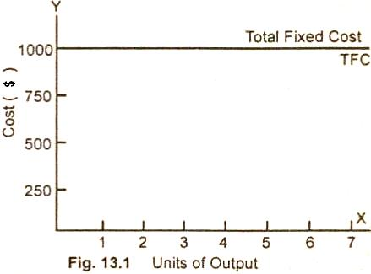
Types of Costs in the Short Run

Slide 119
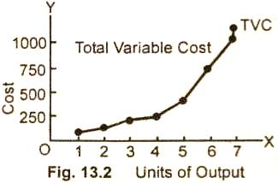
Types of Costs in the Short Run

Slide 120
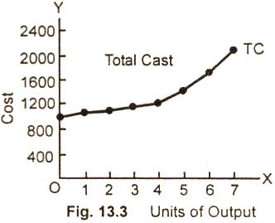
Total Cost Curve Curve/Diagram

Slide 121
Total Cost Curve Curve/Diagram
Total cost curve which is the sum of the total fixed cost and variable cost at various levels of output has nearly the same shape. The difference between the two is by only a fixed amount of $1,000.

Slide 122
Average Cost
The Average Cost is the per unit cost of production obtained by dividing the total cost (TC) by the total output (Q).
it is also called as Per Unit Total Cost.
AC = TC/Q
Also,
AC = Average Variable cost (AVC) + Average Fixed cost (AFC)
Where,
Average variable cost = Total Variable Cost (TVC) / Total output (Q)
Average fixed cost = Total Fixed Cost (TFC) / Total output (Q)

Slide 123
Marginal Cost
The Marginal cost implies the additional cost incurred by a firm for producing one more unit of a commodity.
Suppose a firm incurred Rs. 100 for producing 10 units. If it incurs Rs.107- for producing 11 units, the marginal cost of the 11th unit is Rs.7 (Rs. 107- Rs. 100= Rs. 7).
Marginal cost is the change in the total cost due to the production of one more unit.

Slide 124
Marginal Cost
The marginal cost includes any cost incurred in producing the next unit of the product and hence is expressed as:
MC = ΔTC/ ΔQ
Where,
ΔTC = Change in total cost, ΔQ = change in quantity
The purpose of marginal cost is to determine the point where the firm reaches its economies of scale.

Slide 125
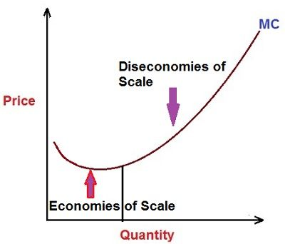
Marginal Cost

Slide 126
TFC100+VC 10 per unit
5 units, AC=30
10 units, AC=20

Slide 127
Marginal Cost
The marginal cost curve shows that cost starts at higher point and declines with the increase in the production. The cost declines with the increase in the level of output because of the economies of scale.
But after some time, the marginal costs starts rising, which shows, the cost increases with the increase in the level of output. This is because the curve reaches the point where diseconomies of scale persist.
The costs rise because the resources from the current source might have completely exhausted and the firm purchases raw materials from other sources at a relatively higher price, hire more management, buy more machines and equipment, etc.

Slide 128
Marginal Cost
Till the price charged for the product is greater than the marginal cost, the revenue will be greater than the added cost and the firm will continue its production.
But, as soon as the price charged is less than the marginal cost, the revenue declines, and it is not wise to expand production.

Slide 129
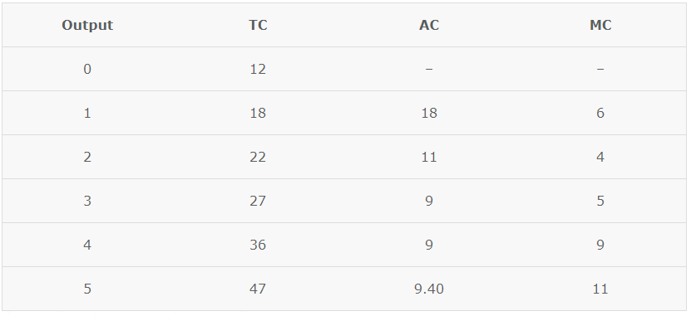
Relationship between Average Cost and Marginal Cost

Slide 130
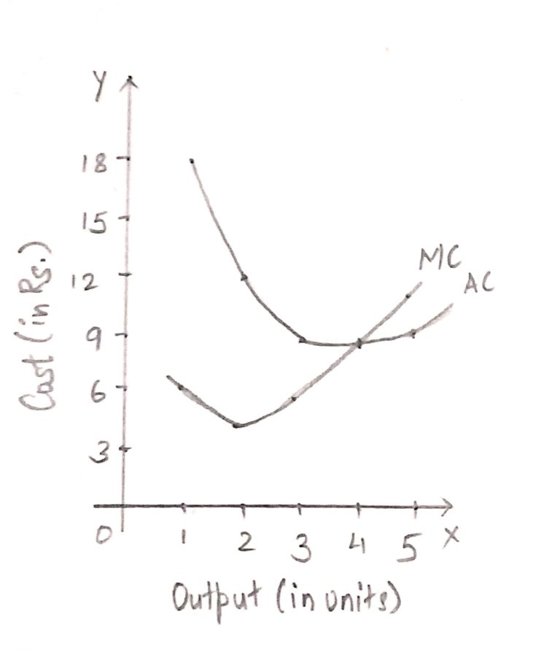
Relationship between Average Cost and Marginal Cost

Slide 131
Relationship between Average Cost and Marginal Cost
When MC is less than AC, AC falls with increase in output, i.e. till 3 units of output. AS MC becomes equal to AC, i.e. when MC curve intersects the AC curve, AC is constant and at its minimum point.
When MC is more than AC, AC rises with increase in output, i.e. from 5 units of output. Thereafter, both AC and MC rise, but MC increases at a faster rate as compared to AC. As a result MC curve is steeper than the AC curve.

Slide 132
National Income
National Income refers to the money value of all the goods and services produced in a country during a financial year.
In other words, the final outcome of all the economic activities of the nation during a period of one year, valued in terms of money is called as a National income.
The economic activities include all the human activities that produce goods and services that can be valued at market price.
Such as production by farmers, production by firms in different industrial sectors, production of goods and services by government, services produced by business intermediaries Viz. Wholesalers and retailers, banks and other financial institutions, educational institutes and professionals like doctors, teachers, lawyers, etc.

Slide 133
National Income
Also, there are non-economic activities that include the production of goods and services but do not have any market value.
Such as hobbies, services of housewives, service to self, an exchange of mutual service between neighbors, etc.
The National Income is a vital macroeconomic variable which determines the business level and economic status of the nation.
The level of national income determines the aggregate demand of goods and services while its distribution defines the pattern of aggregate demand, i.e., what kinds of goods and services are produced and demanded.

Slide 134
Measures of National Income
Gross National Income and Net National Income. Gross National Income refers to the sum of the money value of goods and services produced in an economy during a year.
On the other hand, Net National Income refers to the sum of the real value of goods and services expressed in terms of output produced in an economy during a given year.
Net National income is obtained by deducting the value of depreciation and replacement from the Gross National Income.

Slide 135
Gross and Net Concept
Gross emphasizes that no allowance for capital consumption has been made or that depreciation has yet to be deducted.
Net indicates that provision for capital consumption has already been made or that depreciation has already been deducted.

Slide 136
Measures of National Income
Definition of GDP
Gross Domestic Product or GDP, is the value of everything that is produced within the country’s domestic territory in a particular financial year.
During the calculation of GDP, the primary focus is to capture the goods produced or services rendered within the nation’s border, whether the output is produced by the residents or non-residents of the country. The output produced outside the geographical boundaries of the country are not included in GDP.
GDP is an indicator of the size of the economy. It reflects the aggregate of consumption, investments, spending by the government and net export (export – import). In general, the GDP is calculated for one year.

Slide 137
Measures of National Income
GDP, or gross domestic product, measures the total economic value of all final goods and services produced within a country’s borders during a specific period of time.
GDP is an expression of an economy’s relative health—an increase in GDP indicates a country’s economy is growing and a decrease that it is shrinking.

Slide 138
Types of GDP
Nominal GDP is a country’s economic output at current total market value, meaning that it is often shaped as much by currency inflation as it is by increased economic output.
Real GDP is a country’s output adjusted for inflation. By comparing the year under study to a base year and keeping prices consistent across both, economists isolate and then remove inflation from the equation, providing a more accurate picture of a nation’s actual increases or decreases in economic output.

Slide 139
Measures of National Income
Definition of GNP
Gross National Product or GNP is the total market value of everything (i.e. goods and services) produced by the residents of the country during a particular accounting year.
GNP includes the income earned by the country’s nationals within and outside the country, but it excludes the income earned by the foreign citizens and companies within the country.

Slide 140
Measures of National Income
There are many enterprises which are operating outside the country. Many citizens of a country work in another country. The income earned by all these persons is known as factor income earned from abroad.
Likewise, non-residents render factor services within the domestic territory of the country for which they earn income. When you deduct the factor income paid to non-residents for rendering services from factor income received from abroad, the result will be the Net Factor Income received from Abroad (NFIA).

Slide 141
Difference Between GDP and GNP
In economics, Gross Domestic Product (GDP) is used to calculate the total value of the goods and services produced within a country’s borders, while Gross National Product (GNP) is used to calculate the total value of the goods and services produced by the residents of a country, no matter their location.
Essentially, GDP looks for the amount of economic activity within a nation’s economy, while GNP looks at the value of the economic activity generated by the nation’s people.
This means that GNP will count the economic activities of expatriates and other citizens outside the country’s borders but GDP will not, and that GDP will consider the activities of non-citizens within those borders, but GNP will not.

Slide 142
Difference Between GDP and GNP
Gross domestic product (GDP) and gross national product (GNP) are both widely used measures of a country's aggregate economic output.
GDP measures the value of goods and services produced within a country's borders, by citizens and non-citizens alike.
GNP measures the value of goods and services produced by only a country's citizens but both domestically and abroad.
GDP is the most commonly used by global economies. The United States abandoned the use of GNP in 1991, adopting GDP as its measure to compare itself with other economies.

Slide 143
Inflation
Inflation reduces the purchasing power of each unit of currency, which leads to increases in the prices of goods and services over time.
It's an economics term that means you have to spend more to fill your gas tank, buy a gallon of milk, or get a haircut. In other words, it increases your cost of living.
The rate of inflation measures the annual percentage change in the general price level.
The percentage tells you how quickly prices rose during the period. For example, if the inflation rate for a gallon of gas is 2% per year, then gas prices will be 2% higher next year.

Slide 144
Types of inflation
Cost-push inflation – when a rise in prices is caused by a rise in the cost of production, such as higher oil prices.
Cost-push inflation is a result of a decrease in aggregate supply. A decrease in aggregate supply is mainly caused by an increase in wage rate or an increase in the price of raw materials. Essentially, prices for consumers are pushed up by increases in the cost of production.
Demand-pull inflation – when a rise in prices is caused by rising aggregate demand and firms pushing up prices due to the shortage of goods. That's when demand outpaces supply for goods or services. Buyers want the product so much that they're willing to pay higher prices.

Slide 145
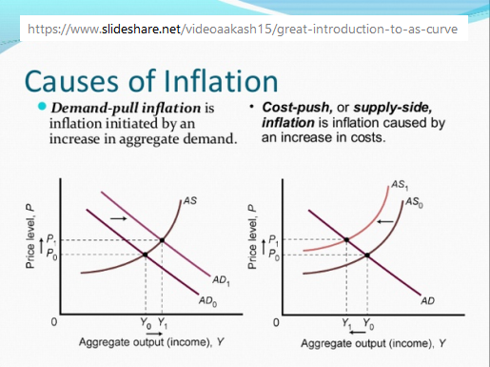

Slide 146
Types of inflation
Built In Inflation
Induced by adaptive expectations, often linked to the “price/wage spiral.
It involves workers trying to keep their wages up with prices and then employers passing higher costs on to consumers as higher prices as part of a “vicious circle.

Slide 147
Deflation
Negative inflation—or deflation—occurs when the supply of goods or services is higher than the demand for those goods or services. This generally happens because the consumer base has less money or credit than they previously had. This results in falling prices for consumer goods and services.
A great example of deflation is the Great Depression(1930), during which the cost of goods fell because people did not have access to money or credit due to unemployment, the stock market crash, and other factors.

Slide 148
Unemployment
Unemployment, also referred to as joblessness, occurs when people are without work and actively seeking employment.
The most frequent measure of unemployment is the unemployment rate, which is the number of unemployed people divided by the number of people in the labor force.
Unemployment is often used as a measure of the health of the economy.

Slide 149
Unemployment
There are two ways of being unemployed, according to economists.
Voluntary unemployment occurs when a person is jobless by choice, rather than due to a lack of employment opportunities. Quitting your job because you just won the lottery and no longer need a steady paycheck is one example of voluntary unemployment.
Involuntary unemployment occurs when a person is willing and able to work for a given wage but cannot find a job. Corporate layoffs following a merger or a downturn in the economy are two examples of involuntary unemployment.

Slide 150
Unemployment
Cyclical Unemployment
Cyclical unemployment occurs when there is not enough aggregate demand in the economy to provide jobs for everyone who wants to work. Demand for goods and services decreases, less production is needed, and fewer workers are needed.
when demand for goods and services declines and companies respond by cutting production and laying off workers, unemployment occurs.
When this happens, there are more workers than there are available jobs. Unemployment is the inevitable result.

Slide 151
Unemployment
Structural unemployment
Structural unemployment happens when the skills set of a worker does not match the skills demands of the jobs available or if the worker cannot reach the geographical location of a job.
An example is a teaching job that requires relocation to China, but the worker cannot secure a work visa due to certain visa restrictions.
It can also happen when there is a technological change in the organization, such as workflow automation.

Slide 152
Unemployment
Frictional unemployment
Frictional unemployment occurs as a result of people voluntarily changing jobs within an economy.
After a person leaves a company, it naturally takes time to find another job. Similarly, graduates just entering the workforce add to frictional unemployment. Usually, this type of unemployment is short-lived.

Slide 153
Cost-Benefit Analysis
A cost-benefit analysis is a process businesses use to analyze decisions.
The business or analyst sums the benefits of a situation or action and then subtracts the costs associated with taking that action.
Before building a new plant or taking on a new project, prudent managers conduct a cost-benefit analysis to evaluate all the potential costs and revenues that a company might generate from the project.
The outcome of the analysis will determine whether the project is financially feasible or if the company should pursue another project.

Slide 154
Cost-Benefit Analysis
A CBA involves measurable financial metrics such as revenue earned or costs saved as a result of the decision to pursue a project.
A CBA can also include intangible benefits and costs or effects from a decision such as employee morale(Morale is a collection of employee’s feelings, attitudes and sentiments towards their jobs, superiors and organization. It reflects a state of mind of people) and customer satisfaction.

Slide 155
Cost-Benefit Analysis Process
The costs involved in a CBA might include the following:
Direct costs would be direct labor involved in manufacturing, inventory, raw materials, manufacturing expenses.
Indirect costs might include electricity, overhead costs from management, rent, utilities.
Intangible costs of a decision, such as the impact on customers, employees, or delivery times.
Opportunity costs such as alternative investments, or buying a plant versus building one.
Cost of potential risks such as regulatory risks, competition, and environmental impacts.

Slide 156
Cost-Benefit Analysis Process
Benefits might include the following:
Revenue and sales increases from increased production or new product.
Intangible benefits, such as improved employee safety and morale, as well as customer satisfaction due to enhanced product offerings or faster delivery.
Competitive advantage or market share gained as a result of the decision.

Slide 157
Payback Period
The payback period refers to the amount of time it takes to recover the cost of an investment. Simply put, the payback period is the length of time an investment reaches a break-even point.
The desirability of an investment is directly related to its payback period.
Shorter paybacks mean more attractive investments, while longer payback periods are less desirable.
The payback period is calculated by dividing the amount of the investment by the annual cash flow.

Slide 158
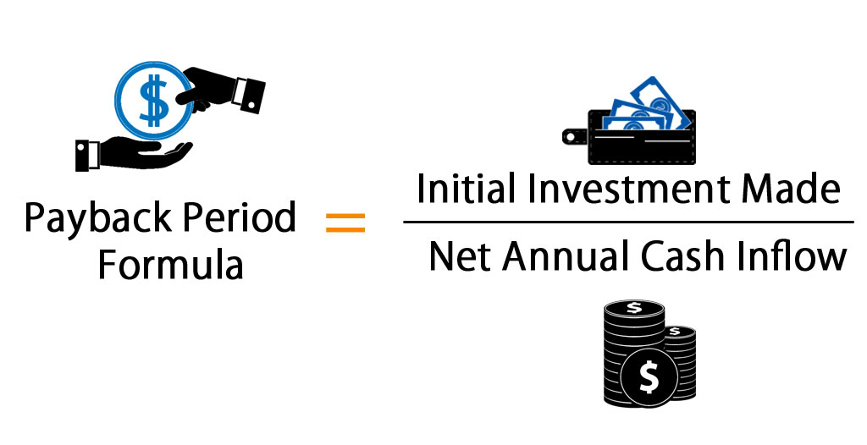
Payback Period

Slide 159
Payback Period
Let's say you have two machines in your warehouse. Machine A costs $20,000 and your firm expects payback at the rate of $5,000 per year. Machine B costs $12,000 and the firm expects payback at the same rate as Machine A. Calculate the two scenarios as follows:
Machine A = $20,000/$5,000 = 4 years
Machine B = $12,000/$5,000 = 2.4 years
With all other things equal, the firm would choose Machine B.

Slide 160
Payback Period
Suppose ABC ltd is analyzing a project which requires an investment of $2,00,000 and it is expected to generate cash flows as follows
Year Annual cash inflows
1 80,000
2 60,000
3 60,000
4 20,000

Slide 161
Payback Period
Year | Annual cash inflows | Cumulative Annual cash inflows | Payback period
1 | 80,000 | 80,000
2 | 60,000 | 1,40,000(80,000+60,000)
3 | 60,000 | 2,00,000(1,40,000+60,000) | In this Year 3 we got initial investment of $ 2,00,000 so this is the pay back year
4 | 20,000 | 2,20,000(2,00,000+20,000)

Slide 162
Payback Period
Suppose, in the above case, if the cash outlay is $2,05,000, then the pay back period will be calculated as follows.
For up to three years, a sum of $2,00,000 is recovered, the balance amount of $ 5,000($2,05,000-$2,00,000) is recovered in a fraction of the year, which is as follows.
For getting $20,000 additional cash flows, the project is taking complete 12 months. So for getting additional of $ 5,000($2,05,000-$2,00,000) it will take (5,000/20,000) 1/4th Year. i.e., 3 months.
So, the project payback period is 3 years 3 months.

Slide 163
Payback Period
Year | Annual cash inflows | Cumulative Annual cash inflows | Payback period
1 | 80,000 | 80,000
2 | 60,000 | 1,40,000(80,000+60,000)
3 | 60,000 | 2,00,000(1,40,000+60,000)
4 | 20,000 | 2,20,000(2,00,000+20,000) | The payback period is between 3 and 4 years

Slide 164
Net Present Value (NPV)
Net present value (NPV) is the difference between the present value of cash inflows and the present value of cash outflows over a period of time. NPV is used in capital budgeting and investment planning to analyze the profitability of a projected investment or project.
Put simply, NPV is used to work out how much money an investment will generate compared with the cost adjusted for the time value of money (one dollar today is worth more than one dollar in the future)

Slide 165

NPV Formula

Slide 166
Net Present Value (NPV)
Where:
Z₁ = Cash flow in time 1
Z₂ = Cash flow in time 2
r = Discount rate
X₀ = Cash outflow in time 0 (i.e. the purchase price / initial investment)

Slide 167
Net Present Value (NPV)
Project 1
Initial investment: $10,000
Discount rate: 10%
Year 1: $5,000
Year 2: $15,000
Year 3: $9,000
Year 4: $18,000

Slide 168
Net Present Value (NPV)
Let’s calculate the present values for each year of the project:
Year 1: 5,000/(1 + .10)^1 = $4,545
Year 2: 15,000/(1 + .10)^2 = $12,397
Year 3: 9,000/(1 + .10)^3 = $6,762
Year 4: 18,000/(1 + .10)^4 = $12,294

Slide 169
Net Present Value (NPV)
Find the summation of these present values and subtract the initial investment amount to find the net present value.
NPV = ($4,545 + $12,397 + $6,762 + $12,294) - $10,000
NPV = $25,998

Slide 170
Net Present Value (NPV)
If... | It means... | Then...
NPV > 0 | the investment would add value to the firm | the project may be accepted
NPV < 0 | the investment would subtract value from the firm | the project may be rejected
NPV = 0 | the investment would neither gain nor lose value for the firm | We should be indifferent in the decision whether to accept or reject the project. This project adds no monetary value. Decision should be based on other factors not explicitly included in the calculation.

Slide 171
Net Present Value (NPV)
Project 2
Initial investment: $5,000
Discount rate: 10%
Year 1: $8,000
Year 2: $16,000

Slide 172
Net Present Value (NPV)
Let’s calculate the present values for each year of the project:
Year 1: 8,000/(1 + .10)^1 = $7,273
Year 2: 16,000/(1 + .10)^2 = $13,223
Here is the resulting formula after the present value is calculated for each cash flow and time period:
NPV = ($7,273 + $13,223) - $5,000
NPV = $15,496

Slide 173
Net Present Value (NPV)
The NPV for Project 1 is $25,998 and Project 2 is $15,496. Since Project 1 has a higher NPV value, Pet Supply Company should invest in that project.

Slide 174
Internal Rate of Return (IRR)
The IRR for a specific project is the rate that equates the net present value of future cash flows from the project to zero.
In other words, if we computed the present value of future cash flows from a potential project using the internal rate as the discount rate and subtracted out the original investment, our net present value of the project would be zero.

Slide 175
Internal Rate of Return (IRR)

Slide 176
Internal Rate of Return (IRR)
The only variable in the internal rate of return equation that management won’t know is the IRR. They will know how much capital is required to start the project and they will have a reasonable estimate of the future income of the investment.
This means we will have solve for the discount rate that will make the NPV equal to zero.

Slide 177
Internal Rate of Return (IRR)
Tom is considering purchasing a new machine, but he is unsure if it’s the best use of company funds at this point in time. With the new $100,000 machine, Tom will be able to take on a new order that will pay $20,000, $30,000, $40,000, and $40,000 in revenue.
You can start with an approximate rate and adjust from there(trial and error basis). Let’s start with 8 percent.

Slide 178
Internal Rate of Return (IRR)

Slide 179
Internal Rate of Return (IRR)
As you can see, our ending NPV is not equal to zero.
Since it’s a positive number, we need to increase the estimated internal rate. Let’s increase it to 10 percent and recalculate.

Slide 180
Internal Rate of Return (IRR)

Slide 181
Internal Rate of Return (IRR)
Based on IRR, a company will decide to either accept or reject a project.
If the IRR of a new project exceeds a company’s required rate of return, that project will most likely be accepted. If IRR falls below the required rate of return, the project should be rejected.
The hurdle rate or required rate of return is a minimum return expected by an organization on the investment they are making. Most organizations keep a hurdle rate, and any project with an Internal Rate of Return exceeding the hurdle rate is considered profitable.

Slide 182
Banking System
Roles of Bangladesh Bank.
Roles of Commercial Banks.

Slide 183


Slide 184
Bangladesh: From LDCs to Developing Nation
BD’s per capita GNI was USD 1274 in 2018 which is above the UN threshold of USD 1230.
In case HAI, BD has scored 73.2, higher than the UN threshold level of 66. Human Assets Index.
On the EVI, BD scored 25.2 which has to be below 32.Economic Vulnerability index

Slide 185
Bangladesh: From LDCs to Developing Nation
Positive Impacts of Graduation:
The new status will help in branding BD.
Investors will be interested to invest in the country given its strength in certain areas such as the size of GDP, exports and population compared to other LDCs.
BD will have more opportunities for taking commercial loans from the international market at a competitive interest rate.
The private sector will also have the opportunity to generate capital from the global financial market.

Slide 186
Bangladesh: From LDCs to Developing Nation
Challenges
Following the LDC graduation, Bangladesh’s market access scenario will change quite significantly. At present, the country enjoys duty free-quota free (DFQF) market access for almost all items in most developed countries including the EU, Canada, Japan, and the US (excepting for apparels) as also in a number of developing countries including India, Japan and South Korea and many others. On graduation, in 2026, Bangladesh will no longer be eligible for DF-QF market access.
The major challenges come in the form of losing various international support measures.

Slide 187
Bangladesh: From LDCs to Developing Nation
There may be a situation where importers of Bangladeshi apparels will be required to pay customs duties while Vietnam will be able to enjoy duty-free market access thanks to its membership in various trading blocs: in the EU (thanks to the EU-Vietnam bilateral FTA) and in China, Japan and Australia (thanks to the RCEP).
The difference in price terms could be as high as 20-25 per cent tariff equivalent since average tariffs on apparel tend to be high compared to most other items in most developed countries (ranging between 10-15 per cent).

Slide 188
Bangladesh: From LDCs to Developing Nation
REQUIRED STEPS:
The strategy for the exporter will need to be to raise price-competitiveness through reduction in costs of production to compensate for the loss of tariff preferences.
Export and market diversification has to be ensured by translating comparative advantage into competitive advantages through up-gradation of process and products and by way of improving labour and capital productivity.

Slide 189
Bangladesh: From LDCs to Developing Nation
A supportive environment will be required where Bangladesh’s investors feel stimulated, encouraged and incentivized to invest, keeping in the purview opportunities in domestic and global markets, and the emerging global demand scenario.
Bangladesh will be required to aggressively pursue the Comprehensive Economic Partnership Agreement (CEPA) type of negotiations with partners who matter.

Slide 190
Bangladesh: From LDCs to Developing Nation
Attracting FDI through triangulation of investment, transport logistics and trade connectivity will be key to product and market diversification. Development of regional value chains and production networks will be called for. Trade and tariff policies will need to be reformed and revised to make these WTO-compatible.

Slide 191
The World Bank
The World Bank is an international organization that offers developmental assistance to middle-income and low-income countries.
Founded in 1944, the World Bank has 189 member nations and aims to reduce poverty in the developing world.
By giving loans and offering advice and training in both the private and public sectors, the World Bank aims to eliminate poverty by helping people help themselves.

Slide 192
The World Bank
The IBRD was the original arm of the World Bank that was responsible for the reconstruction of post-war Europe.
The International Development Association offers loans to the world's poorest countries. These loans come in the form of "credits" and are essentially interest-free.
The International Finance Corporation (IFC) works to promote private sector investments by both foreign and local investors. It provides advice to investors and businesses, and it offers normalized financial market information through its publications, which can be used to compare across markets.

Slide 193
The World Bank
The Multilateral Investment Guarantee Agency (MIGA) supports direct foreign investment into a country by offering security against the investment in the event of political turmoil. These guarantees come in the form of political risk insurance, meaning that MIGA offers insurance against the political risk that an investment in a developing country may bear.
The International Centre for Settlement of Investment Disputes facilitates and works toward a settlement in the event of a dispute between a foreign investor and a local country.

Slide 194
World Trade Organization
The World Trade Organization is a global membership group that promotes and manages free trade.
The World Trade Organization (WTO) is a multilateral organization headquartered in Geneva, Switzerland.
It came into existence on January 1, 1995, as a successor to the General Agreement on Tariffs and Trade (GATT). The organization functions as a central body that facilitates global trade.

Slide 195
World Trade Organization
It creates an international legal framework that ensures the smooth exchange of goods and services among the member countries.
Second, it settles trade disputes. Most conflicts occur when one member accuses another of dumping. That's when it exports goods at a lower price than it costs to produce it. The WTO staff investigates, and if a violation has occurred, the WTO will levy sanctions.
Once the agreements are negotiated, the job of the WTO is to ensure that the signatory countries adhere to their commitments in practice. It also produces research based on the impact of the agreements on the economies of the countries involved.

Slide 196
International Monetary Fund
The International Monetary Fund is a 189-member organization that works to stabilize the global economy.
The IMF meets its goal by targeting three objectives:
It monitors global conditions and identifies risks among its member countries.
2. It advises its members on how to improve their economies.
3. It provides technical assistance and short-term loans to prevent financial crises. The IMF's goal is to prevent these disasters by guiding its members.

Slide 197
International Monetary Fund

Slide 198
National Budget

Slide 199
National Budget

